Slide 1
Chapter 23 – Project planning
CS 425 November 14, 2024
Ian Sommerville,
Software Engineering, 10th Edition
Pearson Education, Addison-Wesley
Note: These are a slightly modified version of Chapter 23 slides available from the author’s site http://iansommerville.com/software-engineering-book/
Chapter 23 Project Planning

Slide 2
Topics covered
Software pricing
Plan-driven development
Project scheduling
Agile planning
Estimation techniques
COCOMO cost modeling
Chapter 23 Project Planning

Slide 3
Project planning
Project planning involves breaking down the work into parts and assign these to project team members, anticipate problems that might arise and prepare tentative solutions to those problems.
The project plan, which is created at the start of a project, is used to communicate how the work will be done to the project team and customers, and to help assess progress on the project.
Chapter 23 Project Planning

Slide 4
Planning stages
Planning Occurs During the Project:
At the proposal stage, when you are bidding for a contract to develop or provide a software system.
During the project startup phase(initiation), when you have to plan who will work on the project, how the project will be broken down into increments, how resources will be allocated across your company, etc.
Periodically throughout the project, when you modify your plan in the light of experience gained and information from monitoring the progress of the work.
Chapter 23 Project Planning

Slide 5
Proposal planning
Planning may be necessary with only outline software requirements.
The aim of planning at this stage is to provide information that will be used in setting a price for the system to customers.
Project pricing involves estimating how much the software will cost to develop, taking factors such as staff costs, hardware costs, software costs, etc. into account
All these items are usually put into a project proposal
Chapter 23 Project Planning

Slide 6
Project startup planning
At this stage, you know more about the system requirements but do not have design or implementation information
Create a plan with enough detail to make decisions about the project budget and staffing.
This plan is the basis for project resource allocation
The startup plan should also define project monitoring mechanisms
A startup plan is still needed for agile development to allow resources to be allocated to the project
Chapter 23 Project Planning

Slide 7
Development planning
The project plan should be regularly amended as the project progresses and you know more about the software and its development
The project schedule, cost-estimate and risks have to be regularly revised
Chapter 23 Project Planning

Slide 8
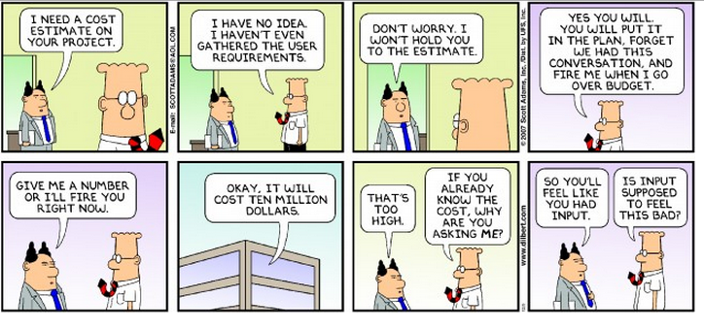
Software pricing
Chapter 23 Project Planning

Slide 9
Software pricing
Estimates are made to discover the cost, to the developer, of producing a software system.
You take into account, hardware, software, travel, training and effort costs.
There is not a simple relationship between the development cost and the price charged to the customer.
Broader organisational, economic, political and business considerations influence the price charged.
Chapter 23 Project Planning

Slide 10
Factors affecting software pricing
Factor | Description
Contractual terms | A customer may be willing to allow the developer to retain ownership of the source code and reuse it in other projects. The price charged may then be less than if the software source code is handed over to the customer.
Cost estimate uncertainty | If an organization is unsure of its cost estimate, it may increase its price by a contingency over and above its normal profit.
Financial health | Developers in financial difficulty may lower their price to gain a contract. It is better to make a smaller than normal profit or break even than to go out of business. Cash flow is more important than profit in difficult economic times.
Chapter 23 Project Planning

Slide 11
Factors affecting software pricing
Factor | Description
Market opportunity | A development organization may quote a low price because it wishes to move into a new segment of the software market. Accepting a low profit on one project may give the organization the opportunity to make a greater profit later. The experience gained may also help it develop new products.
Requirements volatility | If the requirements are likely to change, an organization may lower its price to win a contract. After the contract is awarded, high prices can be charged for changes to the requirements.
Chapter 23 Project Planning

Slide 12
Pricing strategies
Under pricing
A company may underprice a system in order to gain a contract that allows them to retain staff for future opportunities
A company may underprice a system to gain access to a new market area
Increased pricing
The price may be increased when a buyer wishes a fixed-price contract and so the seller increases the price to allow for unexpected risks
Chapter 23 Project Planning

Slide 13
Pricing to win
The software is priced according to what the software developer believes the buyer is willing to pay
If this is less that the development costs, the software functionality may be reduced accordingly with a view to extra functionality being added in a later release
Additional costs may be added as the requirements change and these may be priced at a higher level to make up the shortfall in the original price
Chapter 23 Project Planning

Slide 14
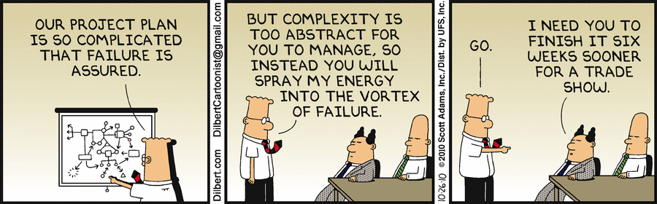
Plan-driven development
Chapter 23 Project Planning

Slide 15
Plan-driven development
Plan-driven or plan-based development is an approach to software engineering where the development process is planned in detail.
Plan-driven development is based on engineering project management techniques and is the ‘traditional’ way of managing large software development projects.
A project plan is created that records the work to be done, who will do it, the development schedule and the work products.
Managers use the plan to support project decision making and as a way of measuring progress.
Chapter 23 Project Planning

Slide 16
Plan-driven development – pros and cons
The arguments in favor of a plan-driven approach are that early planning allows organizational issues (availability of staff, other projects, etc.) to be closely taken into account, and that potential problems and dependencies are discovered before the project starts, rather than once the project is underway.
Allows for risk mitigation
The principal argument against plan-driven development is that many early decisions have to be revised because of changes to the environment in which the software is to be developed and used.
Chapter 23 Project Planning

Slide 17
Project plans
In a plan-driven development project, a project plan sets out the resources available to the project, the work breakdown and a schedule for carrying out the work.
Plan sections
Introduction
Project organization
Risk analysis
Hardware and software resource requirements
Work breakdown
Project schedule
Monitoring and reporting mechanisms
Chapter 23 Project Planning

Slide 18
Project plan supplements
Plan | Description
Configuration management plan | Describes the configuration management procedures and structures to be used.
Deployment plan | Describes how the software and associated hardware (if required) will be deployed in the customer’s environment. This should include a plan for migrating data from existing systems.
Maintenance plan | Predicts the maintenance requirements, costs, and effort.
Quality plan | Describes the quality procedures and standards that will be used in a project.
Validation plan | Describes the approach, resources, and schedule used for system validation.
Chapter 23 Project Planning

Slide 19
The planning process
Project planning is an iterative process that starts when you create an initial project plan during the project startup phase.
Plan changes are inevitable.
As more information about the system and the project team becomes available during the project, you should regularly revise the plan to reflect requirements, schedule and risk changes.
Changing business goals also leads to changes in project plans. As business goals change, this could affect all projects, which may then have to be re-planned.
Chapter 23 Project Planning

Slide 20
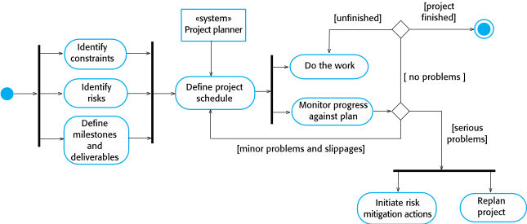
The project planning process
Chapter 23 Project Planning

Slide 21
Planning assumptions
You should make realistic rather than optimistic assumptions when you are defining a project plan.
Problems of some description always arise during a project, and these lead to project delays.
Your initial assumptions and scheduling should therefore take unexpected problems into account.
You should include contingency in your plan so that if things go wrong, then your delivery schedule is not seriously disrupted.
Chapter 23 Project Planning

Slide 22
Risk mitigation
If there are serious problems with the development work that are likely to lead to significant delays, you need to initiate risk mitigation actions to reduce the risks of project failure.
In conjunction with these actions, you also have to re-plan the project.
This may involve renegotiating the project constraints and deliverables with the customer. A new schedule of when work should be completed also has to be established and agreed with the customer.
Chapter 23 Project Planning

Slide 23
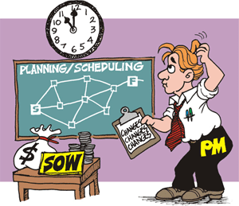
Project scheduling
Chapter 23 Project Planning

Slide 24
Project scheduling
Project scheduling is the process of deciding how the work in a project will be organized as separate tasks, and when and how these tasks will be executed.
You estimate the calendar time needed to complete each task, the effort required and who will work on the tasks that have been identified.
You also have to estimate the resources needed to complete each task, such as the disk space required on a server, the time required on specialized hardware, such as a simulator, and what the travel budget will be.
Chapter 23 Project Planning

Slide 25
Project scheduling activities
Split project into tasks and estimate time and resources required to complete each task.
Organize tasks concurrently to make optimal use of workforce.
Minimize task dependencies to avoid delays caused by one task waiting for another to complete.
Dependent on project managers intuition and experience.
Chapter 23 Project Planning

Slide 26
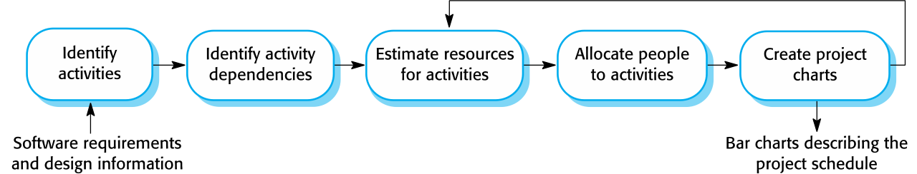
The project scheduling process
Chapter 23 Project Planning

Slide 27
Scheduling problems
Estimating the difficulty of problems and hence the cost of developing a solution is hard.
Productivity is not proportional to the number of people working on a task.
Adding people to a late project makes it later because of communication overheads.
The unexpected always happens. Always allow contingency in planning.
Chapter 23 Project Planning

Slide 28
Schedule presentation
Graphical notations are normally used to illustrate the project schedule.
These show the project breakdown into tasks. Tasks should not be too small. They should take about a week or two.
Calendar-based
Bar charts are the most commonly used representation for project schedules. They show the schedule as activities or resources against time.
Activity networks
Show task dependencies
Chapter 23 Project Planning

Slide 29
Project activities
Project activities (tasks) are the basic planning element. Each activity has:
a duration in calendar days or months,
an effort estimate, which shows the number of person-days or person-months to complete the work,
a deadline by which the activity should be complete,
a defined end-point, which might be a document, the holding of a review meeting, the successful execution of all tests, etc.
Chapter 23 Project Planning

Slide 30
Milestones and deliverables
Milestones are points in the schedule against which you can assess progress, for example, the handover of the system for testing.
Deliverables are work products that are delivered to the customer, e.g. a requirements document for the system.
Chapter 23 Project Planning

Slide 31
Tasks, durations, and dependencies
Task | Effort (person-days) | Duration (days) | Dependencies
T1 | 15 | 10
T2 | 8 | 15
T3 | 20 | 15 | T1 (M1)
T4 | 5 | 10
T5 | 5 | 10 | T2, T4 (M3)
T6 | 10 | 5 | T1, T2 (M4)
T7 | 25 | 20 | T1 (M1)
T8 | 75 | 25 | T4 (M2)
T9 | 10 | 15 | T3, T6 (M5)
T10 | 20 | 15 | T7, T8 (M6)
T11 | 10 | 10 | T9 (M7)
T12 | 20 | 10 | T10, T11 (M8)
Chapter 23 Project Planning

Slide 32
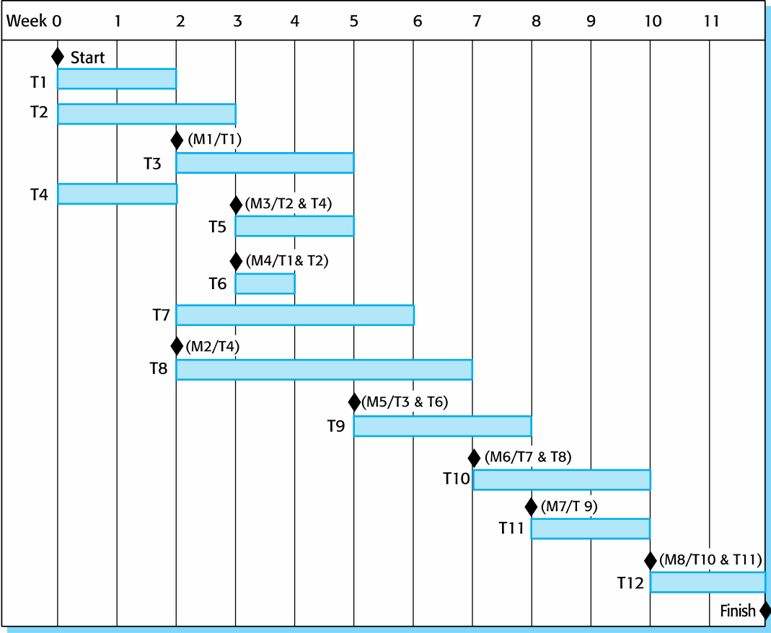
Activity bar chart
Chapter 23 Project Planning

Slide 33
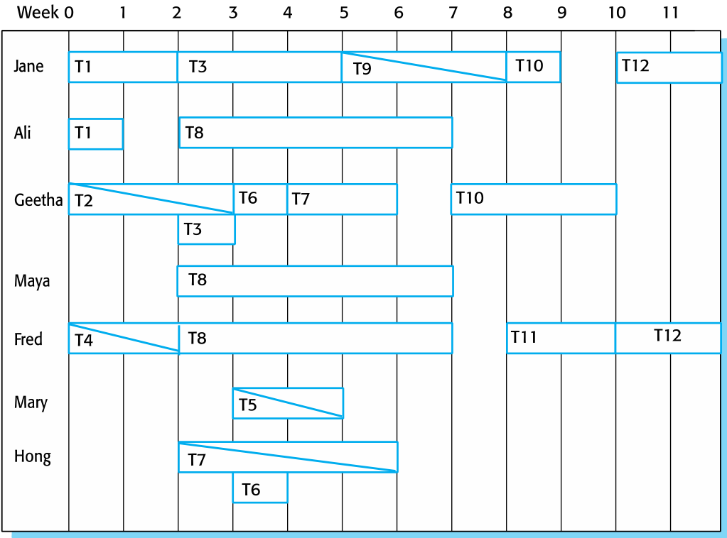
Staff allocation chart
Chapter 23 Project Planning

Slide 34
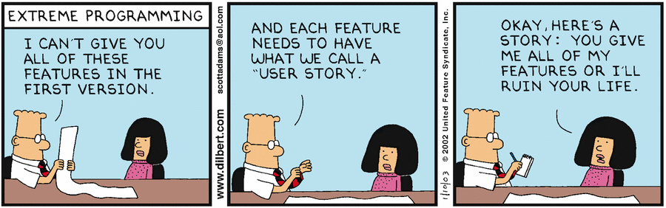
Agile planning
Chapter 23 Project Planning

Slide 35
Agile planning
Agile methods of software development are iterative approaches where the software is developed and delivered to customers in increments.
Unlike plan-driven approaches, the functionality of these increments is not planned in advance but is decided during the development.
The decision on what to include in an increment depends on progress and on the customer’s priorities.
The customer’s priorities and requirements change so it makes sense to have a flexible plan that can accommodate these changes.
Chapter 23 Project Planning

Slide 36
Agile planning stages
Release planning, which looks ahead for several months and decides on the features that should be included in a release of a system.
Iteration planning, which has a shorter term outlook, and focuses on planning the next increment of a system. This is typically 2-4 weeks of work for the team.
Chapter 23 Project Planning

Slide 37
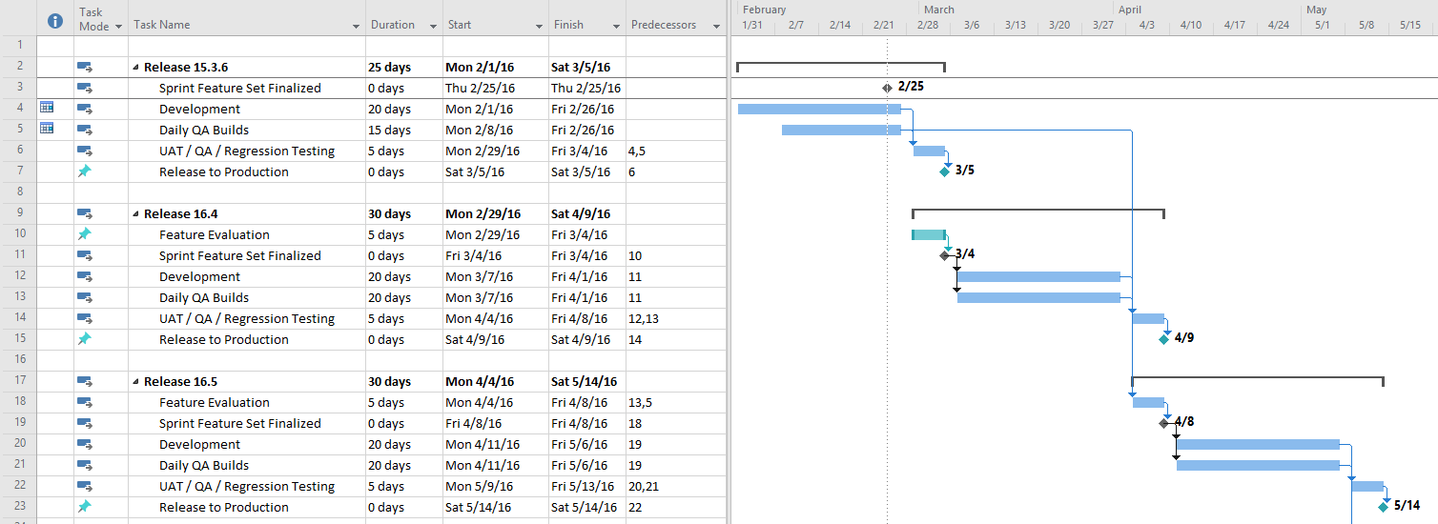
Chapter 23 Project Planning

Slide 38
Normal Monthly Release
Monthly Sprint 1
Monthly Sprint 2
Monthly Sprint 3
Development
Dev Resolution of QA Found Issues
Product and BA Evaluation
Daily QA Builds and Testing
QA Regression Testing
User Acceptance Testing
Development
Dev Resolution of QA Found Issues
Daily QA Builds and Testing
QA Regression Testing
User Acceptance Testing
Product and BA Evaluation
Development
Daily QA Builds and Testing
Product and BA Evaluation

Slide 39
Sprint Example
Monthly Sprint Example 17.12 (December)
Development
Dev Resolution of QA Found Issues
Product and BA Evaluation
User Acceptance Testing
Daily QA Builds and Testing
QA Regression Testing
Case Selection Begins 9/11/17
Cases Finalized 10/6/17
Feature Freeze
10/25/17
Code Freeze
11/3/17
UAT 11/20/17
Release 12/2/17

Slide 40
Approaches to agile planning
Planning in Scrum
Covered in Chapter 3
Based on managing a project backlog (things to be done) with daily reviews of progress and problems
The planning game
Developed originally as part of Extreme Programming (XP)
Dependent on user stories as a measure of progress in the project
Chapter 23 Project Planning

Slide 41
What is a User Story?
A description of a software feature from an end-user perspective
It describes who the user is and what they want and why
A user story helps create a simplified description of a requirement and what it should achieve
RECOMMENDED FORMAT
User stories typically follow a simple template:
As a <type of user>, I want <some goal> so that <some reason>.
Notes:
This is not in the book

Slide 42
Story-based planning
The planning game is based on user stories that reflect the features that should be included in the system.
The project team read and discuss the stories and rank them in order of the amount of time they think it will take to implement the story.
Stories are assigned ‘effort points’ reflecting their size and difficulty of implementation
The number of effort points implemented per day is measured giving an estimate of the team’s ‘velocity’
This allows the total effort required to implement the system to be estimated
Chapter 23 Project Planning
Notes:
https://www.youtube.com/watch?v=sCCUEtjCpCs

Slide 43
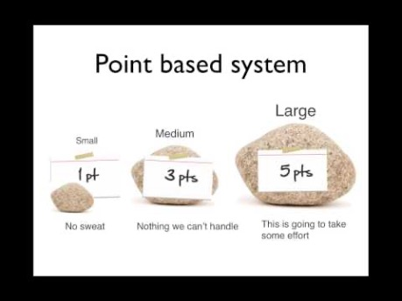
Video: Estimation the Fine Art of Guessing
Chapter 23 Project Planning

Slide 44
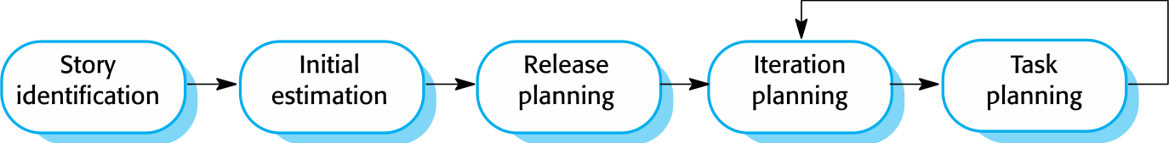
The planning game
Chapter 23 Project Planning

Slide 45
Release and iteration planning
Release planning involves selecting and refining the stories that will reflect the features to be implemented in a release of a system and the order in which the stories should be implemented.
Stories to be implemented in each iteration are chosen, with the number of stories reflecting the time to deliver an iteration (usually 2 or 3 weeks).
The team’s velocity is used to guide the choice of stories so that they can be delivered within an iteration.
Chapter 23 Project Planning

Slide 46
Task allocation
During the task planning stage, the developers break down stories into development tasks.
A development task should take 4–16 hours.
All of the tasks that must be completed to implement all of the stories in that iteration are listed.
The individual developers then sign up for the specific tasks that they will implement.
Benefits of this approach:
The whole team gets an overview of the tasks to be completed in an iteration.
Developers have a sense of ownership in these tasks and this is likely to motivate them to complete the task.
Chapter 23 Project Planning

Slide 47
Software delivery
A software increment is always delivered at the end of each project iteration.
If the features to be included in the increment cannot be completed in the time allowed, the scope of the work is reduced.
The delivery schedule is never extended.
Chapter 23 Project Planning

Slide 48
Agile planning difficulties
Agile planning is reliant on customer involvement and availability.
This can be difficult to arrange, as customer representatives sometimes have to prioritize other work and are not available for the planning game.
Furthermore, some customers may be more familiar with traditional project plans and may find it difficult to engage in an agile planning process.
Chapter 23 Project Planning

Slide 49
Agile planning applicability
Agile planning works well with small, stable development teams that can get together and discuss the stories to be implemented.
However, where teams are large and/or geographically distributed, or when team membership changes frequently, it is practically impossible for everyone to be involved in the collaborative planning that is essential for agile project management.
Chapter 23 Project Planning

Slide 50
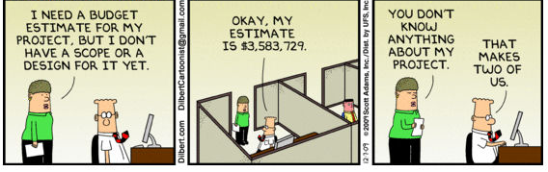
Estimation techniques
Chapter 23 Project Planning

Slide 51
Estimation techniques
Organizations need to make software effort and cost estimates. There are two types of technique that can be used to do this:
Experience-based techniques The estimate of future effort requirements is based on the manager’s experience of past projects and the application domain. Essentially, the manager makes an informed judgment of what the effort requirements are likely to be.
Algorithmic cost modeling In this approach, a formulaic approach is used to compute the project effort based on estimates of product attributes, such as size, and process characteristics, such as experience of staff involved.
Chapter 23 Project Planning

Slide 52
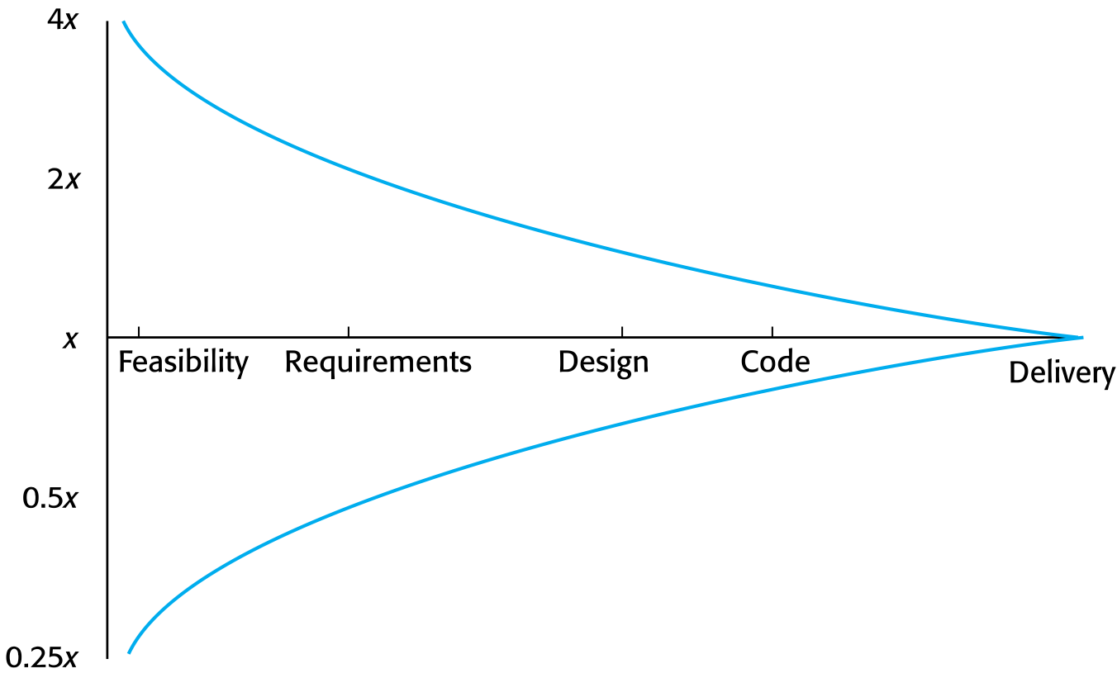
Estimate uncertainty
Chapter 23 Project Planning

Slide 53
Experience-based approaches
Experience-based techniques rely on judgments based on experience of past projects and the effort expended in these projects on software development activities.
Typically, you identify the deliverables to be produced in a project and the different software components or systems that are to be developed.
You document these in a spreadsheet, estimate them individually and compute the total effort required.
It usually helps to get a group of people involved in the effort estimation and to ask each member of the group to explain their estimate.
Chapter 23 Project Planning

Slide 54
Problem with experience-based approaches
The difficulty with experience-based techniques is that a new software project may not have much in common with previous projects.
Software development changes very quickly and a project will often use unfamiliar techniques such as web services, application system configuration or HTML5.
If you have not worked with these techniques, your previous experience may not help you to estimate the effort required, making it more difficult to produce accurate costs and schedule estimates.
Chapter 23 Project Planning

Slide 55
Key points
The price charged for a system does not just depend on its estimated development costs and the profit required by the development company. Organizational factors may mean that the price is increased to compensate for increased risk or decreased to gain competitive advantage.
Software is often priced to gain a contract and the functionality of the system is then adjusted to meet the estimated price.
Plan-driven development is organized around a complete project plan that defines the project activities, the planned effort, the activity schedule and who is responsible for each activity.
Chapter 23 Project Planning

Slide 56
Key points
Project scheduling involves the creation of various graphical representations of part of the project plan. Bar charts, which show the activity duration and staffing timelines, are the most commonly used schedule representations.
A project milestone is a predictable outcome of an activity or set of activities. At each milestone, a formal report of progress should be presented to management. A deliverable is a work product that is delivered to the project customer.
The agile planning game involves the whole team in project planning. The plan is developed incrementally and, if problems arise, it is adjusted so that software functionality is reduced instead of delaying the delivery of an increment.
Chapter 23 Project Planning

Slide 57
Key points
Estimation techniques for software may be experience-based, where managers judge the effort required, or algorithmic, where the effort required is computed from other estimated project parameters.
Chapter 23 Project Planning

Slide 58
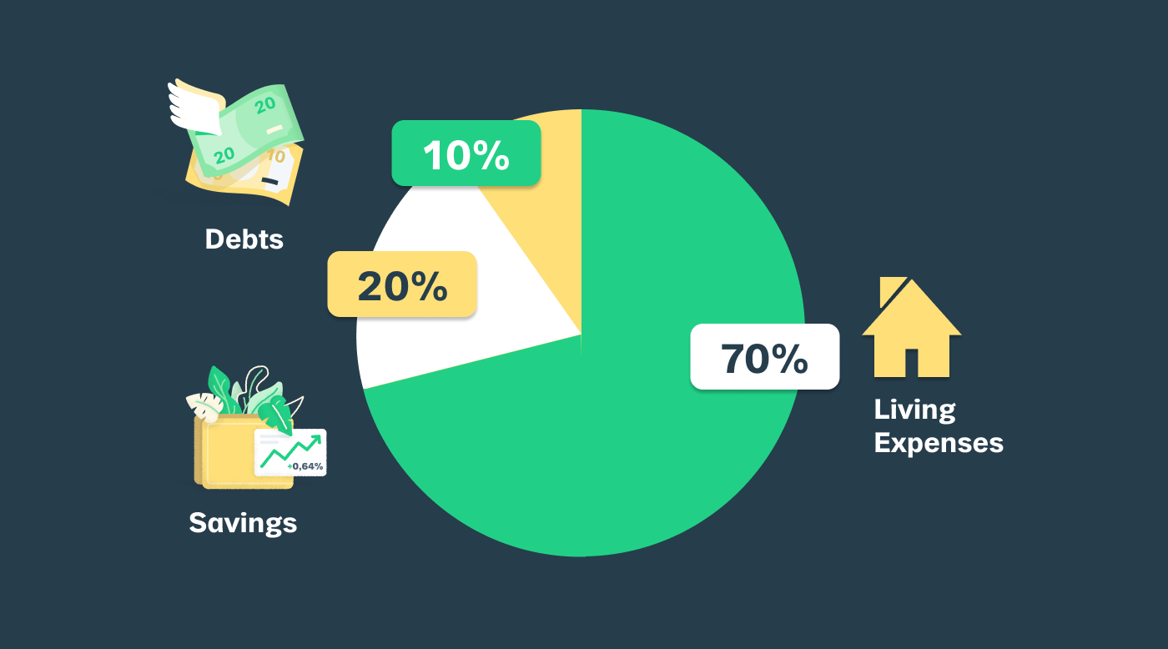
Professional Tip of the Day: The 70/20/10 Rule for Post Tax Income
Chapter 23 Project Planning

